Slide 1
Some open issues on reconnection
The trigger/onset problem
Effect of reconnection on turbulence (e.g., dissipation)
Effect of turbulence on reconnection
3D reconnection
Heating and acceleration by reconnection
Controlling reconnection in fusion plasmas
and more

Slide 2
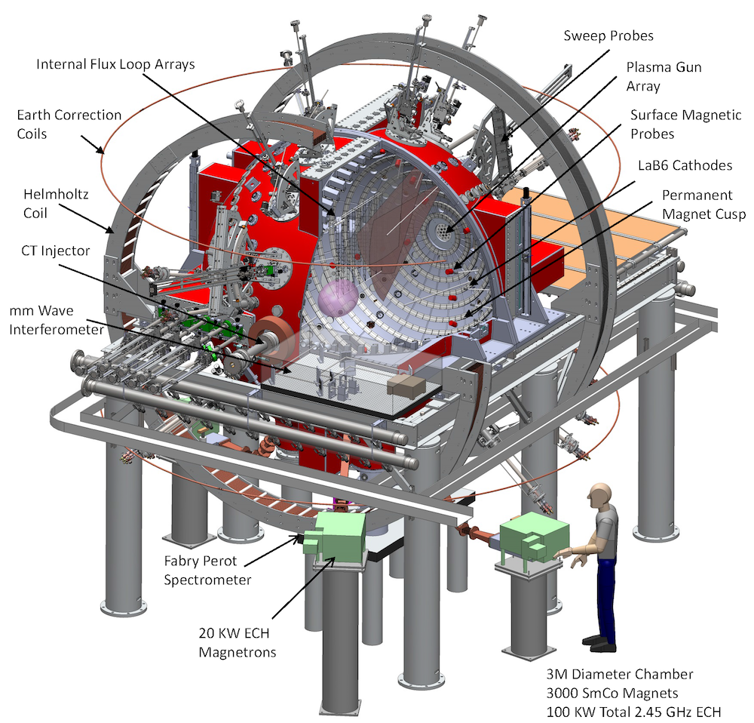
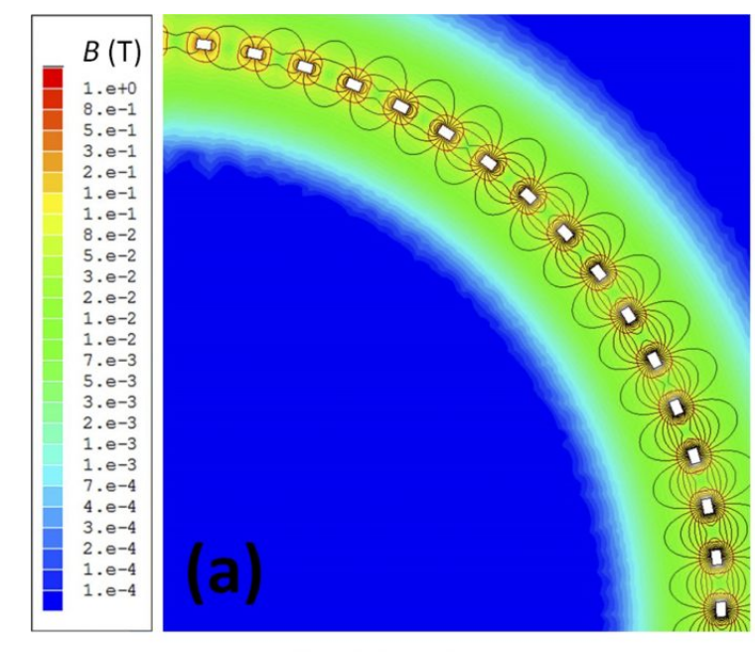
New or recent experimental developments
Extending basic experiments to new regimes
The Big Red Ball (Wisconsin)
Can confine an ~ field-free plasma (very high beta)

Slide 3
New or recent experimental developments
Extending basic experiments to new regimes
The Big Red Ball (Wisconsin)
Can add magnetic field and drive reconnection

Slide 4
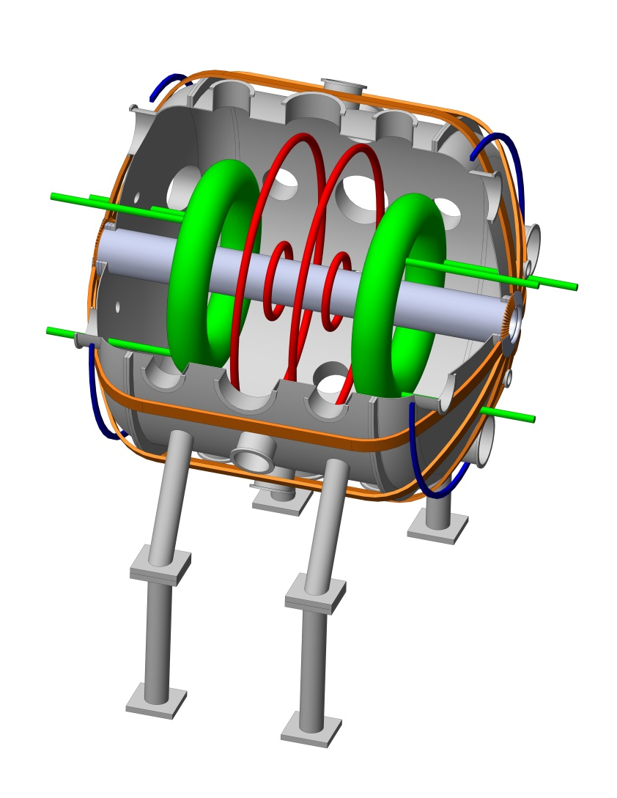
New or recent experimental developments
Extending basic experiments to new regimes
FLARE (Princeton)
(Facility for Laboratory Reconnection Experiments
Access new regimes important for astrophysics
3 m

Slide 5
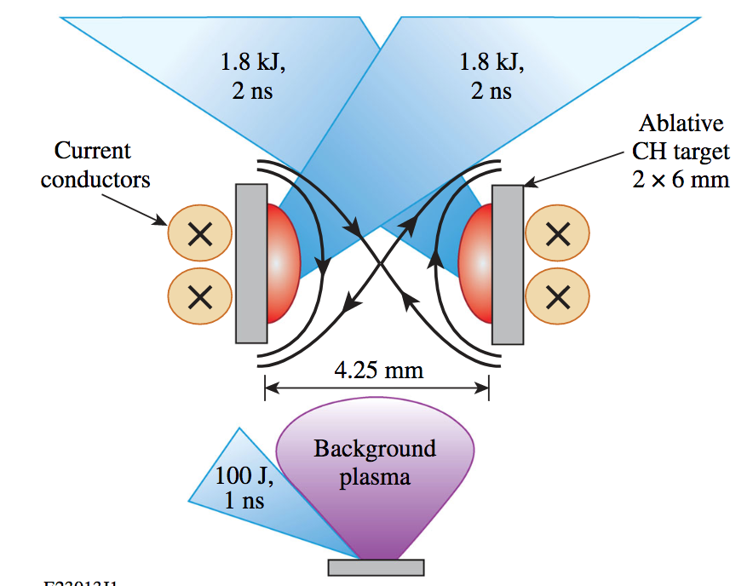
New or recent experimental developments
Extending basic experiments to new regimes
Studying reconnection in high energy density plasmas
Can access kinetic regimes

Slide 6
New or recent experimental developments
Extending basic experiments to new regimes
Studying reconnection in high energy density plasmas
Space observations

Slide 7
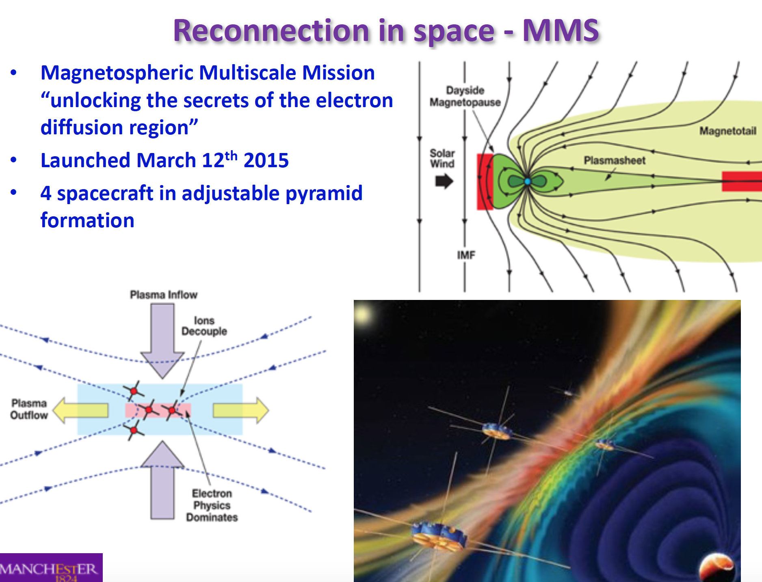

Slide 8
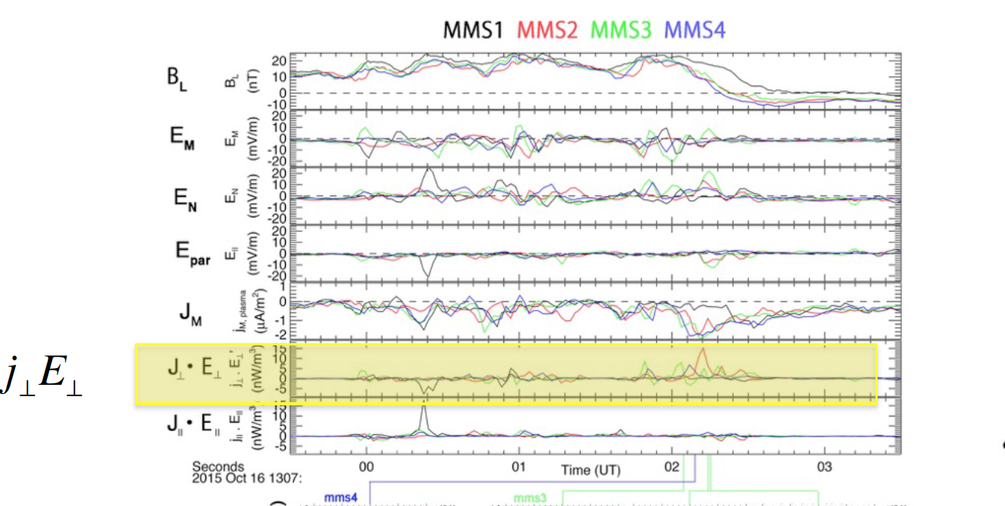
Provides detailed measurements
e.g., energy dissipation
Just launched – Parker Solar Probe, to probe the outer solar corona

